Slide 1
Booking Price Forecasting: Smart Models for Revenue Management
Alexandra Gladkova
Christina Saju
Hao Lun Rong
Kushwanth Sai Kolli
Ladan Asempour

Slide 2
Table of contents
01
02
03
04
05
Problem Statement
Dataset Overview & Data Preparation
Time Series Decomposition
Forecasting Model Comparison
App Demo

Slide 3
Problem Statement
Hotels need accurate price forecasts for revenue management and resource planning
Booking prices are influenced by seasonality, holidays, guest types, and external events
Goal: Predict future booking prices using historical data

Slide 4
Dataset Overview
Source: Kaggle hotel bookings dataset (119,390 samples, 32 columns)
Key features:
Hotel type, guest demographics, booking info, stay details
Target variable: Booking Price (ADR × Length of stay)
Data spans over 25 months

Slide 5
Data Preparation & Feature Engineering
Handled missing values:
Children → filled with median,
Country → filled with mode
Agent & Company → converted to binary (present = 1, missing = 0)
Key transformations:
Countries (177) grouped into 7 continents → dummy variables
Agent, Company, Meal Plan → converted to numeric/binary
Target Variable: Estimated booking price = ADR × Stay Duration
Applied skew-reducing transformations (Yeo-Johnson) to handle outliers

Slide 6
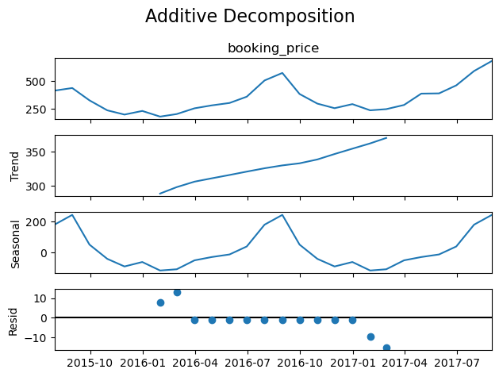
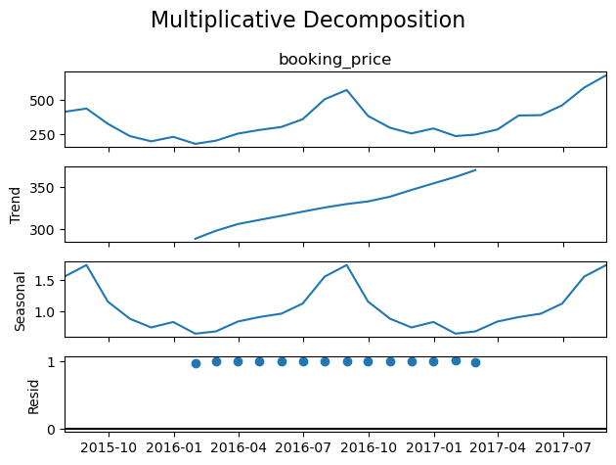
Time Series Decomposition
Decomposed booking price into:
Trend (steady increase)
Seasonality (summer peaks, winter dips)
Residuals (low noise)
Chose Multiplicative decomposition for better seasonal scaling
Insight: Seasonality and long-term trend strongly influence prices

Slide 7
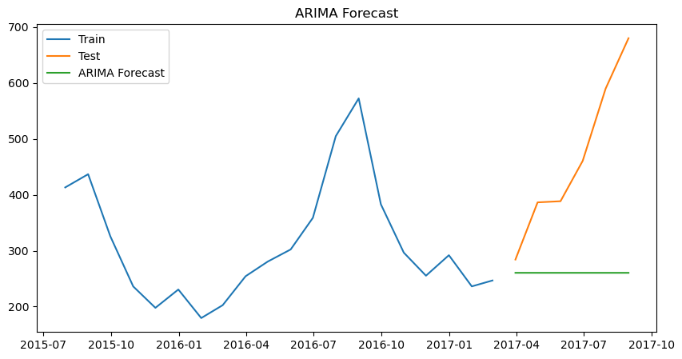
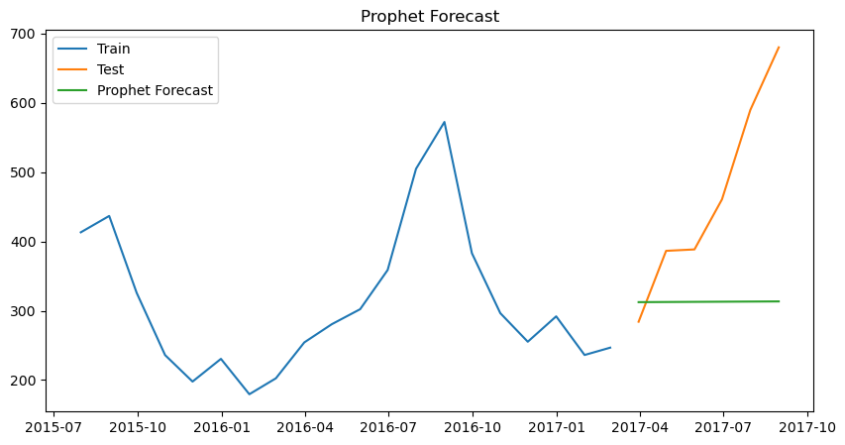
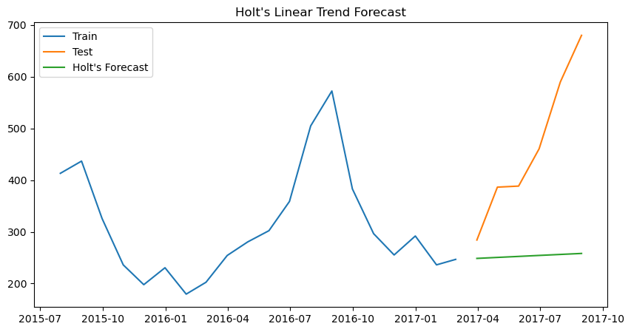
Forecasting Model Comparison
ARIMA, Holt, and Prophet models failed to capture seasonal trends in the data.
The forecasted lines (green) show only a slight upward movement, not reflecting monthly or seasonal fluctuations.
This is likely due to the short time span of the dataset, which captures a little over a year’s worth of seasonality in the training set.
Their performance mainly differs by the starting point of the forecast line, which directly impacts the error metrics.

Slide 8
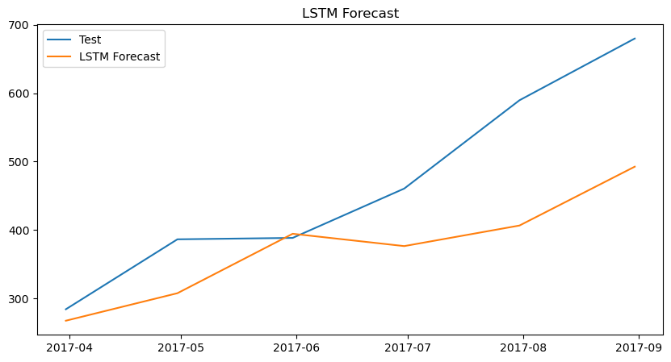
Forecasting Model Comparison
Performs significantly better in short-term forecasting scenarios.
Visually, the LSTM model follows the shape of the test data more accurately.
It captures fluctuations in behaviour more effectively than the other models, resulting in much lower MAE, RMSE, and MAPE values.

Slide 9
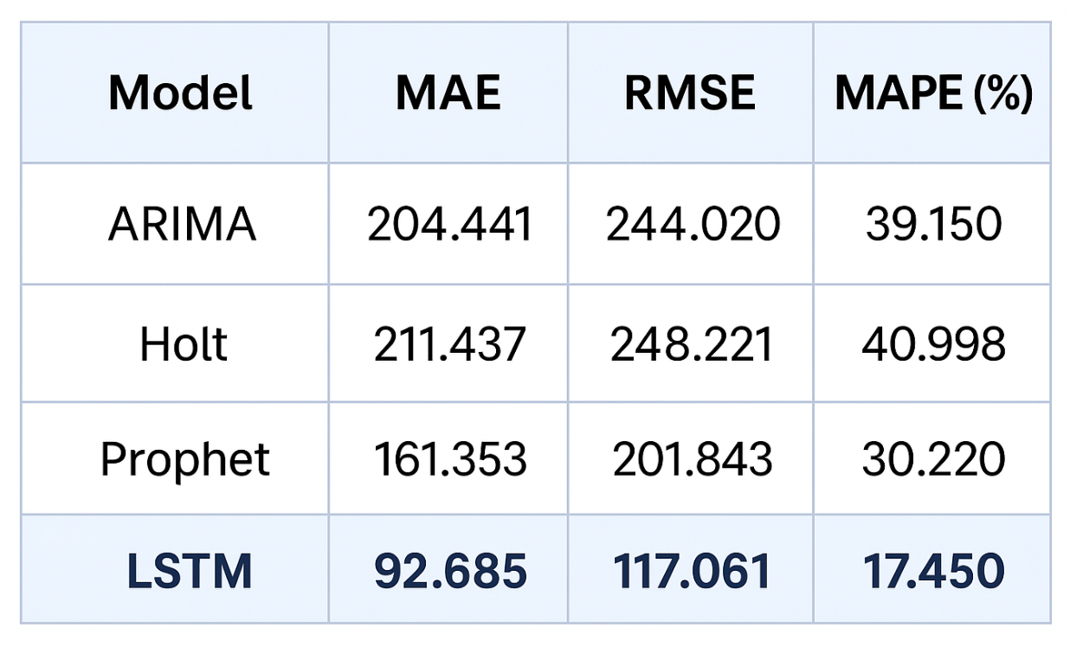
Forecasting Model Comparison
LSTM significantly outperforms the others in all metrics (MAE, RMSE, MAPE).
Prophet performs second-best, better than Holt and ARIMA.
ARIMA and Holt show high errors, with Prophet slightly underperforming Holt but still better than ARIMA.

Slide 10
Streamlit Web App
Key Features
Automated Data Cleaning Handles missing data and formats everything for reliable analysis
Visualize Booking Trends Interactive charts show how bookings change over time and across months
Identify Seasonal Patterns Understand peak vs. slow seasons with clear seasonal decomposition
Forecast Future Bookings Get accurate occupancy predictions for better planning
Performance Metrics Evaluate prediction quality using simple, clear accuracy scores
What the App Does
Upload your hotel booking data—no coding required
Automatically cleans, analyzes, and forecasts future bookings
Supports smarter decisions for staffing, pricing, and marketing
Why It’s Useful
Saves Time: No manual cleaning or model building needed
Empowers Decision-Making: Plan with confidence using real insights
Beginner-Friendly: Simple, intuitive interface—no data expertise needed
Competitive Advantage: Stay ahead by forecasting demand more effectively
App Demo Video

Slide 11
Thanks!
Q&A

